Slide 1
The Regression Analysis of Basketball Players in Video Game
Jian Sun
11/28/2015

Slide 2
Introduction
I love play basketball video games. And when I learn regression analysis, I always think if I could research the players in video game. We plan to study the basketball players’ overall value and their characteristic by the knowledge we learn in class.
Keywords: regression analysis, multiple linear regression, confidence interval, principle component analysis

Slide 3




Slide 4
Variables and Model
meaning | variable
Speed | Z1
Moving Shot Close | Z2
Moving Shot Mid-Range | Z3
Draw Foul | Z4
Offensive Rebound^2+Defensive Rebound^2/ Offensive | Z5
Steal | Z6
Block | Z7
Vertical | Z8
Strength | Z9

Slide 5
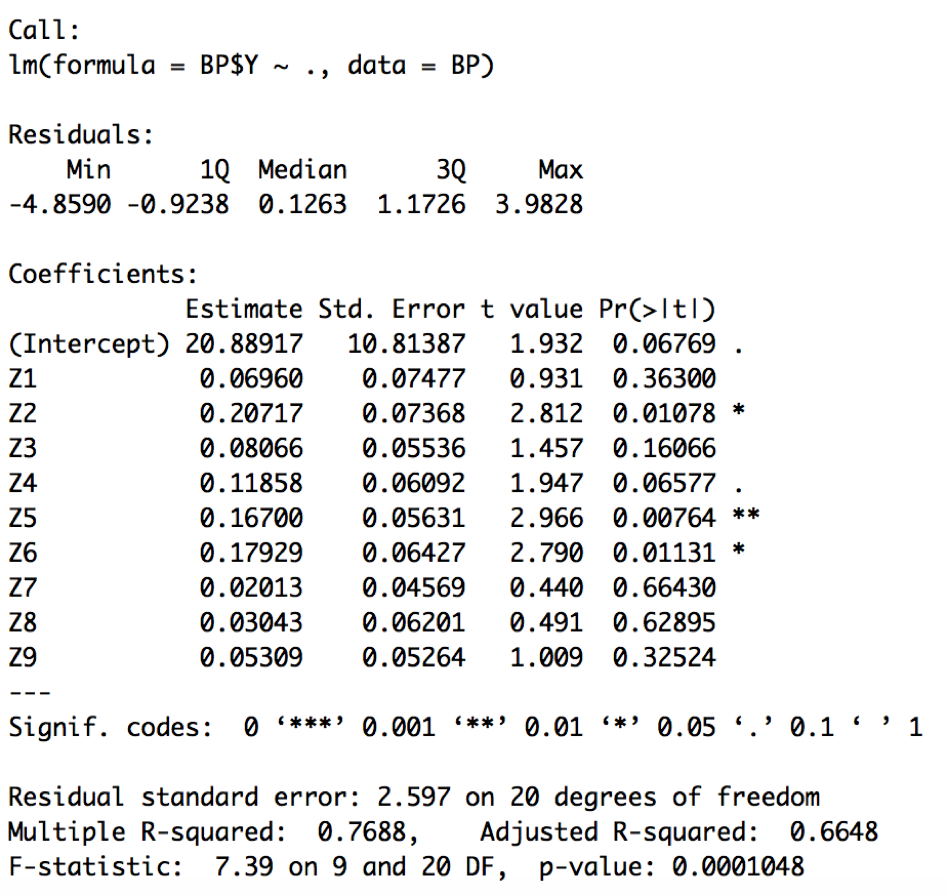
overall value model
our initial full model is
, then we check the coefficients table, we find that
Yhat=20.89+0.07Z1+0.21Z2+0.08Z3+0.12Z4+0.17Z5+0.18Z6+0.02Z7+0.03Z8+0.05Z9
there are only three significant variables. So we have to change the model, but given the meaning of the variable, it is not possible to delete all of six. Then we turn to scatter plot to find answer.

Slide 6
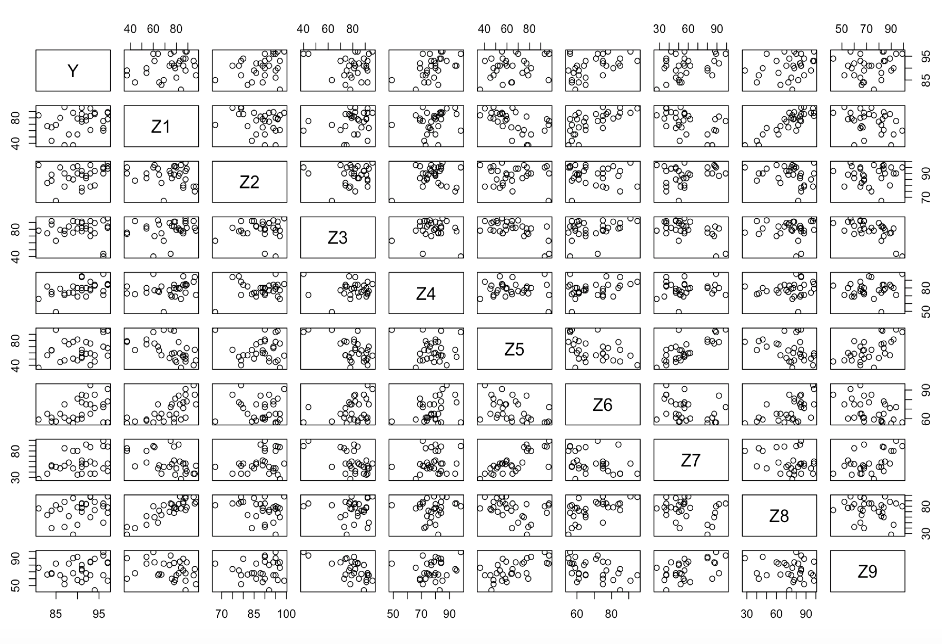

Slide 7
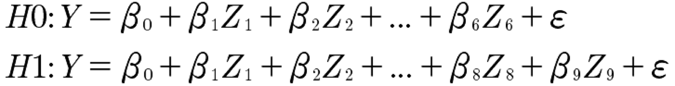
After checking the rationality of all the parameters, we start to check if B7=B8=B9=0
we set the null hypothesis and the alternative hypothesis as following
the result is F=0.517<3.098=F(3,20,0.05), so we agree with the null hypothesis and refit the reduced model 1.

Slide 8
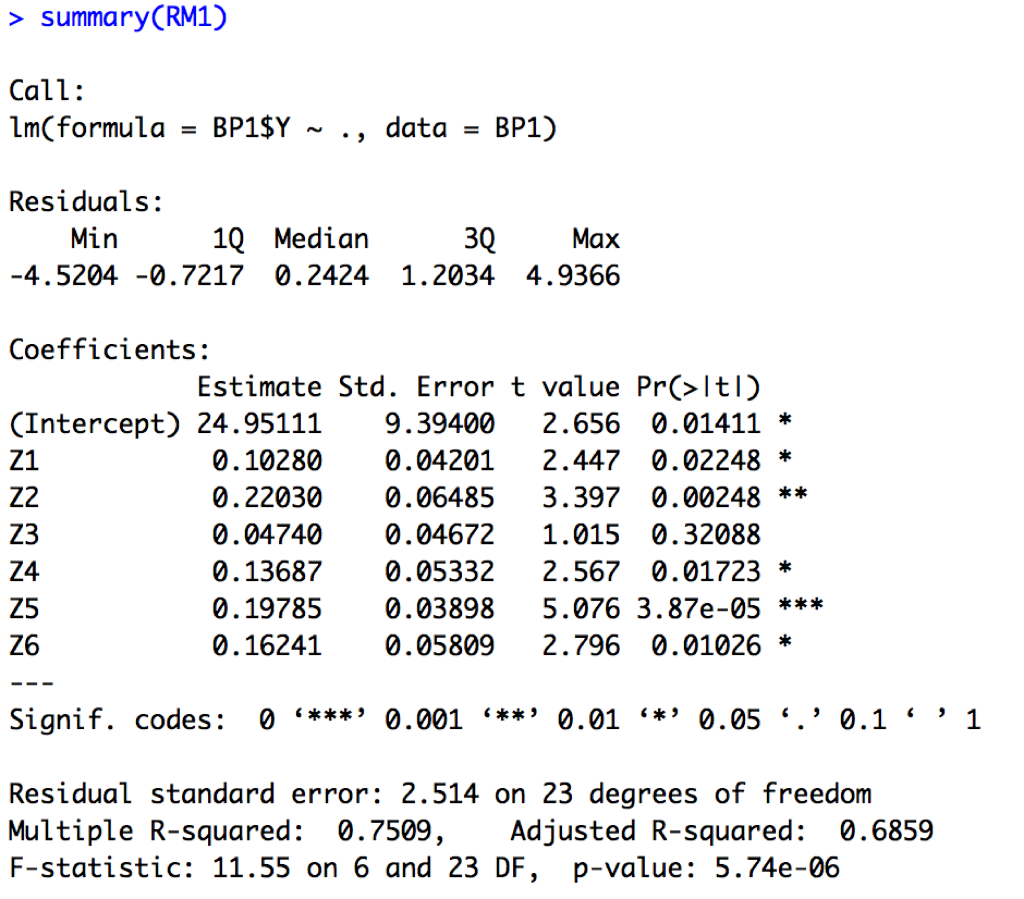
As we check the coefficient table of reduced model 1, we find the old problem as well. The parameter of Z3 is not significant.
So we drop the Z3, and refit the model again.
This time we get the reduced model 2.
Here are it’s coefficients table and standard residual plot.

Slide 9
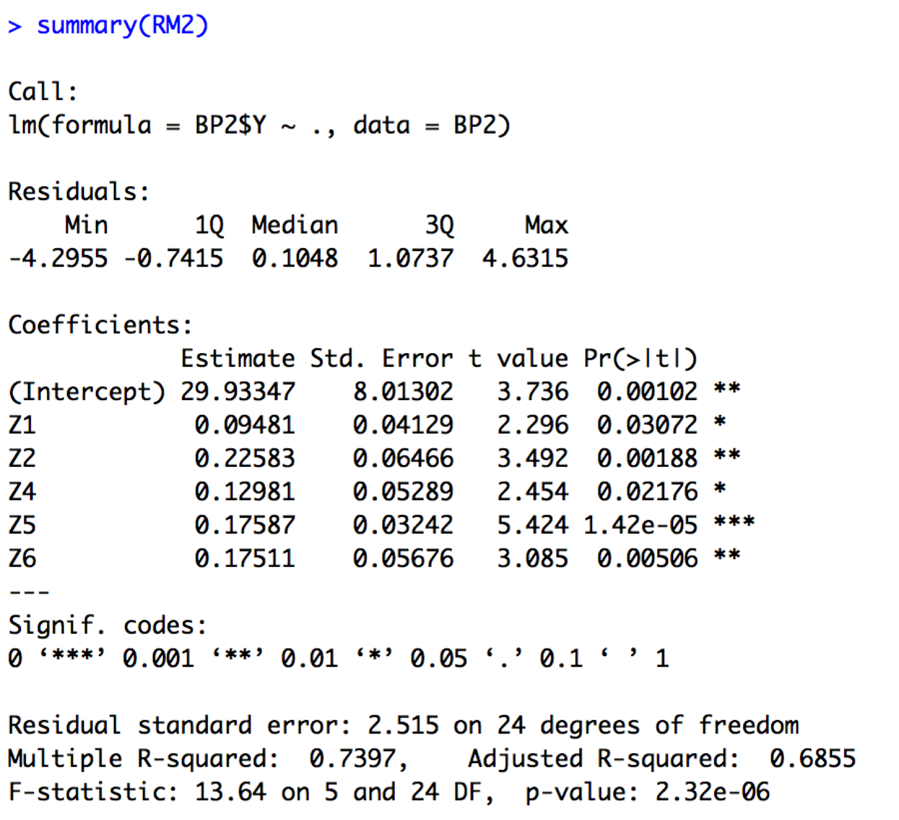
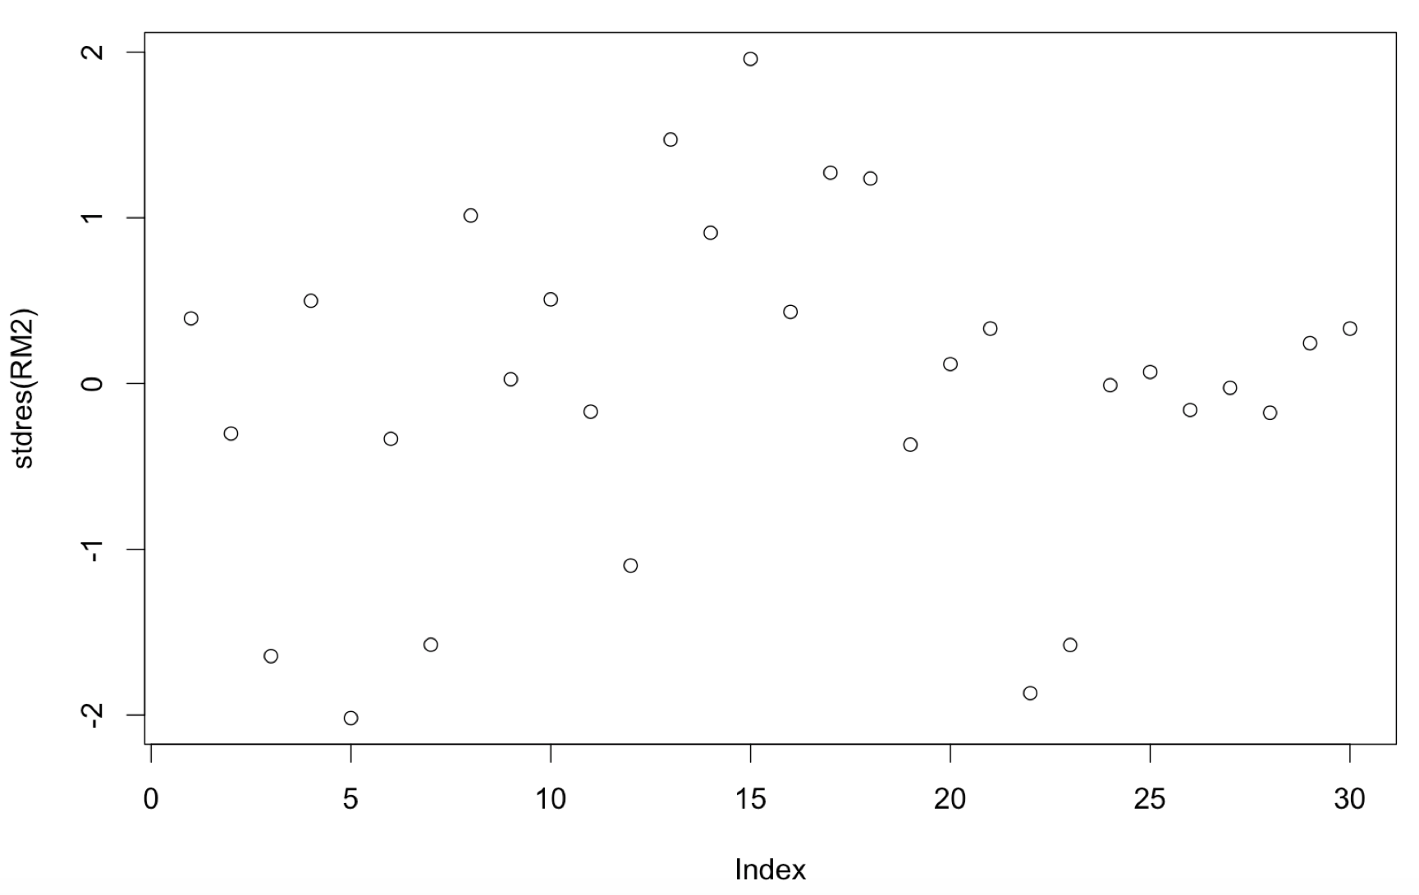

Slide 10
So finally, our basketball player’s overall value model is
Y=29.933+0.095Z1+0.226Z2+0.13Z4+0.176Z5+0.175Z6+e
And we find the correlation coefficient of this model is 73.97%, so the predict variable2 are account for 73.97% of the model. The relationship between response variable and predict variable is tight.

Slide 11
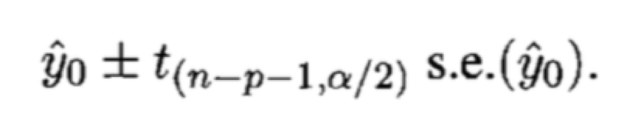
predicting a player’s overall interval
We decide to apply the player’s overall value model to do some prediction.
We collect the data of Blake Griffin, and try to calculate the confidence interval of his overall value by the following formula.
s.ey0hat = 3.44;
t(23,0.025) = 2.0639 ; y0hat = 91.768

Slide 12
The result is that Griffin’s overall is from 84.67 to 98.87. And the observation of that is 90.
So our model is reasonable. And the Griffin has potential to increase his overall higher than 92.
Next, we will use principle component to analyze the player’s feature in the basketball court.

Slide 13
principle component analysis
We set some new indexes.
If the standardized variables have strong positive relation with the new indexes, then those indexes reflect the phenomenon of positive related variables.
For example, X1=english, X2=history, X3=literature, X4=math, X5=physics, X6=chemistry.
C=2X1+X2+3X3-X4-X5-X6

Slide 14
So C reflects the art behavior.
The above is not an absolutely right explanation, but it is easy for us to understand the function of PCA(principle component analysis)
Next, we will launch our last analysis

Slide 15
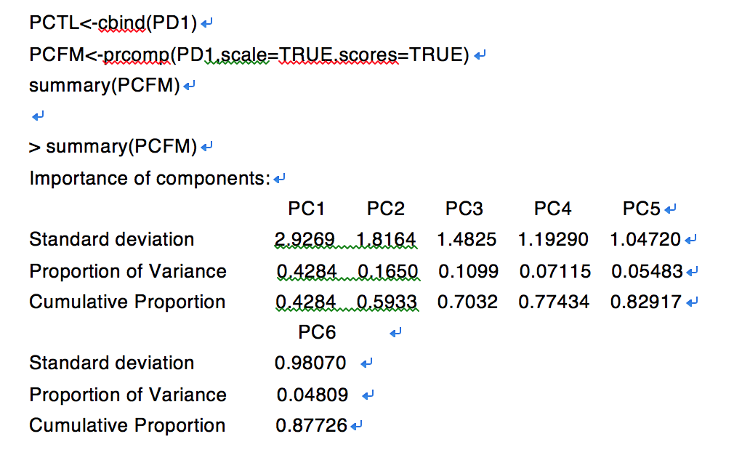
confirm the player’s feature
let the cumulative proportion to be 85%.
We notice that five components are enough to explain the standardized predict variables.

Slide 16
After that, according to the following equation
We get five principle component equations, which are PC1, PC2, PC3, PC4, PC5.
Please check the specific formulas in my paper.
PC1 reflects player’s defense ability;
PC2 reflects the player’s attacking and score capability;

Slide 17
PC3 reflects the player’s comprehensive ability.
PC4 reflects the player’s breakthrough capability.
PC5 reflects the player’s basic skills.
We analyzed 4 players,
LeBron James, PC1=-1.0275; PC2=2.3707; PC3=-0.6348; PC4=0.4051; PC5=-0.7888.
Tim Duncan, PC1=4.4460; PC2=2.0203; PC3=-0.5134; PC4=-0.1616; PC5=1.8579.
Michael Jordan, PC1=-2.7218, PC2=-0.4809; PC3=3.0197; PC4=-0.9712; PC5=-0.7105.
Larry Bird, PC1=-1.1484; PC2=1.9187; PC3=1.3100; PC4=-1.4902; PC5=-1.3467

Slide 18
The results we get are that LeBron James is expert at scoring and breakthrough,
Tim Duncan is a defense guru who can get score well in basketball court,
Michael Jordan is master of omnipotence,
Larry Bird is a good attacker and a comprehensive player as well.
These results are accord with the realistic situation.

Slide 19
What’s more, we think our results do a favor for coach to put better players into starting line-up. For example, between Larry Bird and LeBron James, we will choose Larry Bird to be the starting line-up based on our principle component analysis. And even if some star player get injured. The coach can use this way to check whether a good player in another position can do his job in game. If there are more players in our dataset, we could evaluate other players too.
For future work, we plan to use original players’ data to fit model and do PCA, even we want to predict the player’s overall value in each game.

Slide 20
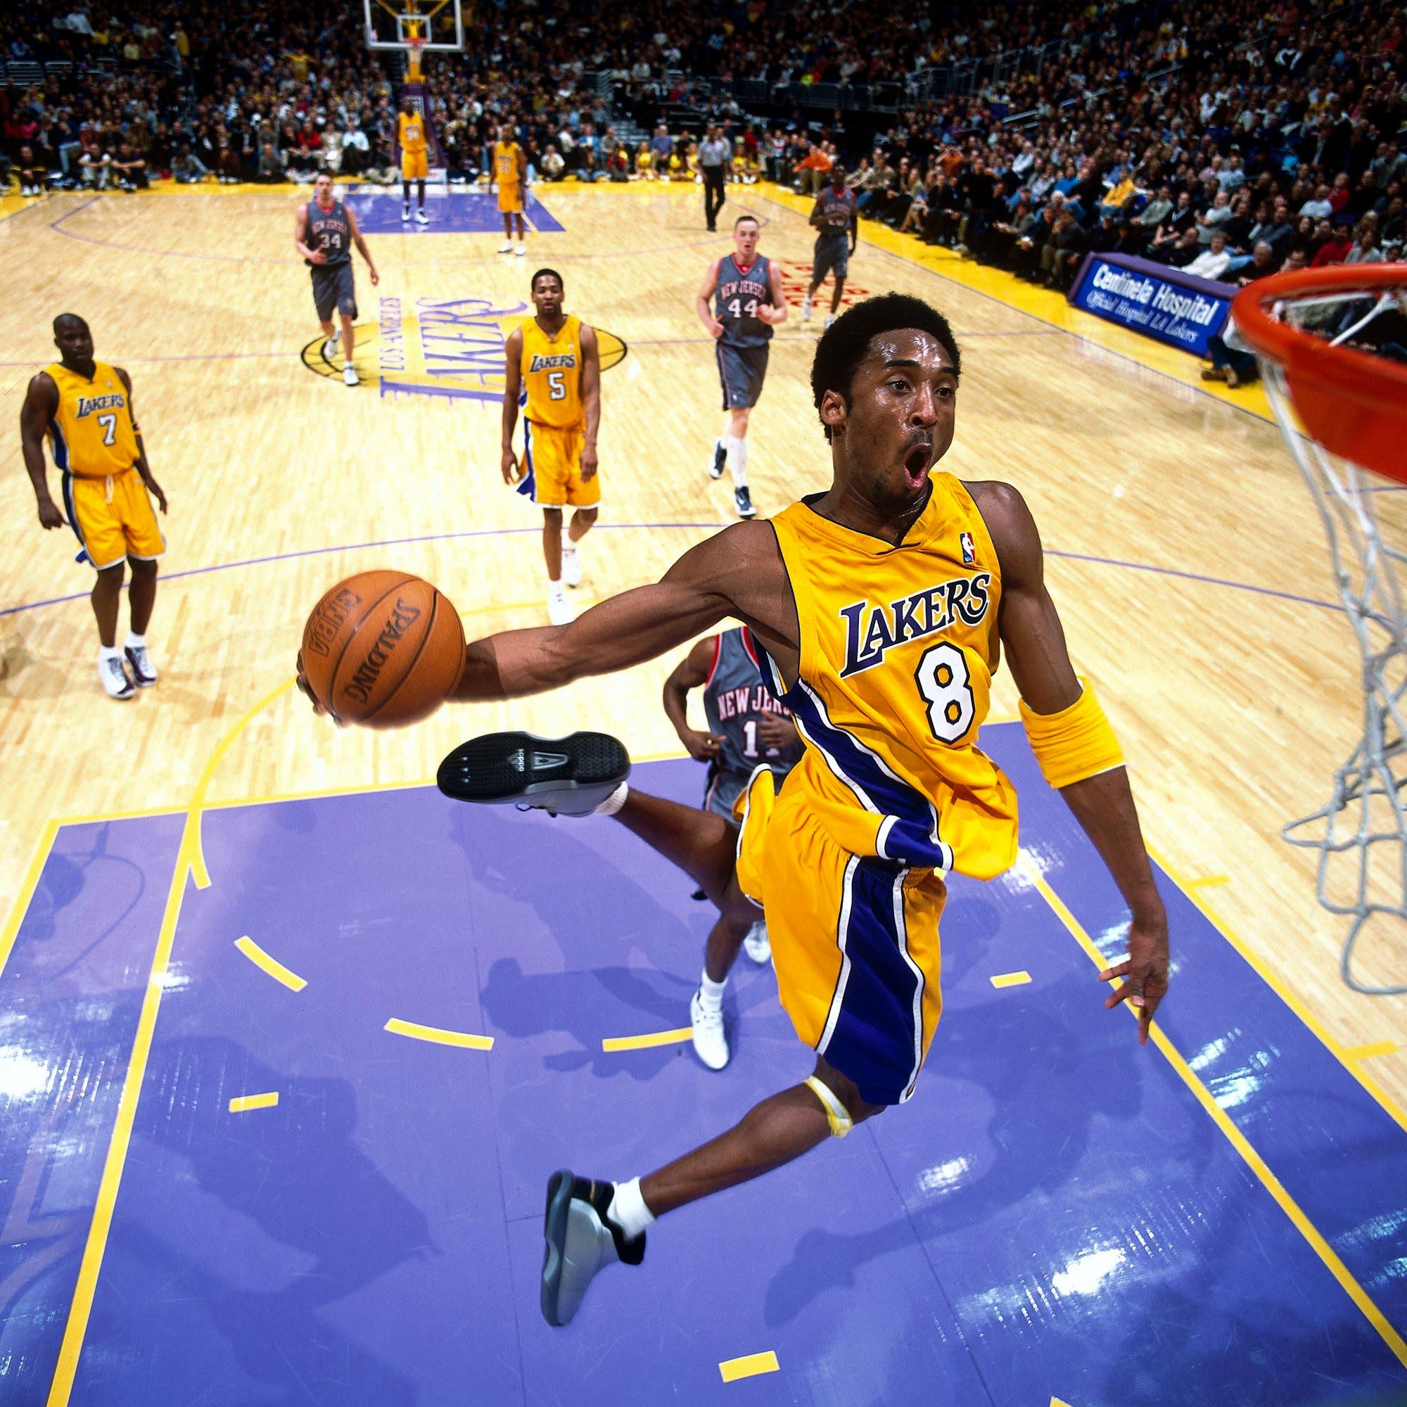
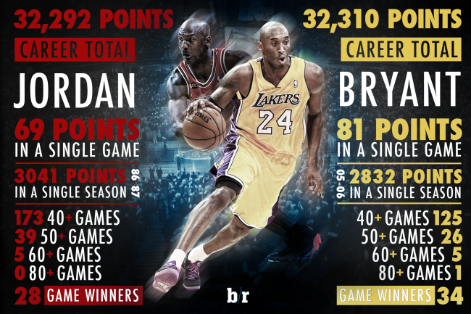
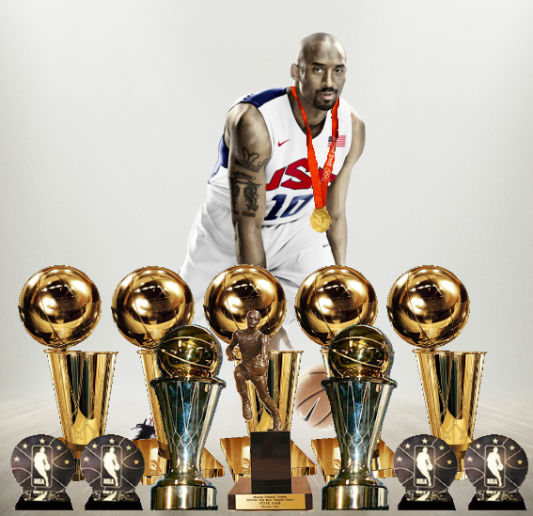

Slide 21


Salute to Kobe
You are the fantastic part of my youth!

Slide 22
Thank you for watching
The End

